Slide 1
Pandemio
EGHI/GT HACK COVID-19

Slide 2
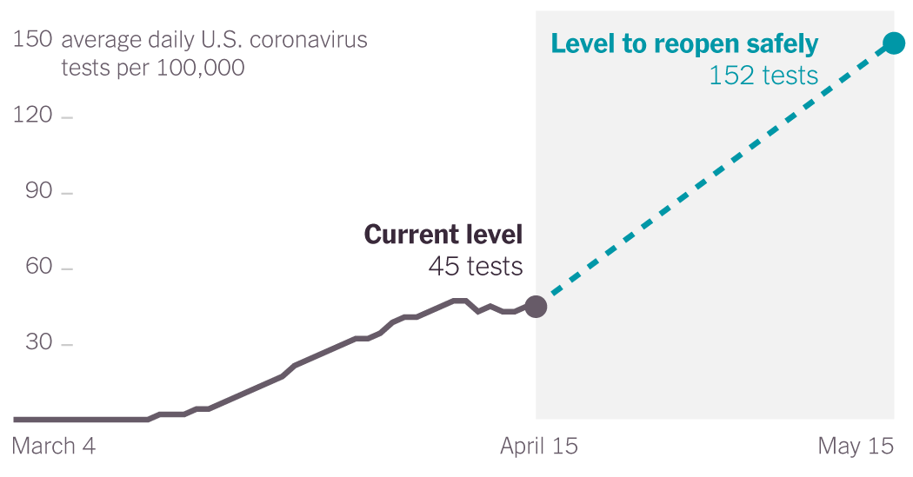
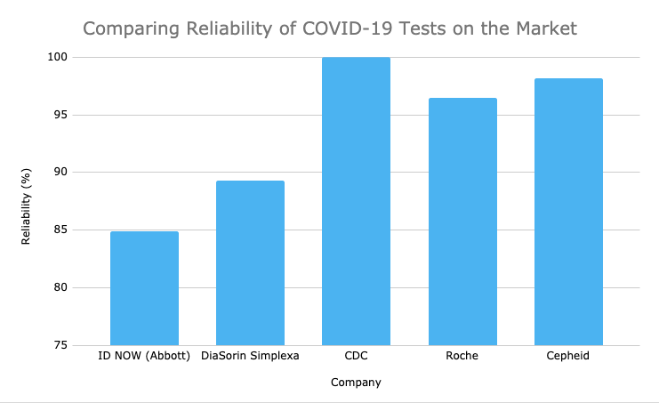
The Importance of Reliable Testing
As talk of reopening some sectors of business & education grow, testing will become increasingly important, particularly in the United States.
Additionally, reliability varies between tests and can have a large effect on the health of a population. For example, ID NOW by Abbott is over 10% less reliable, meaning there can be thousands more false negatives when the testing availability builds up

Slide 3

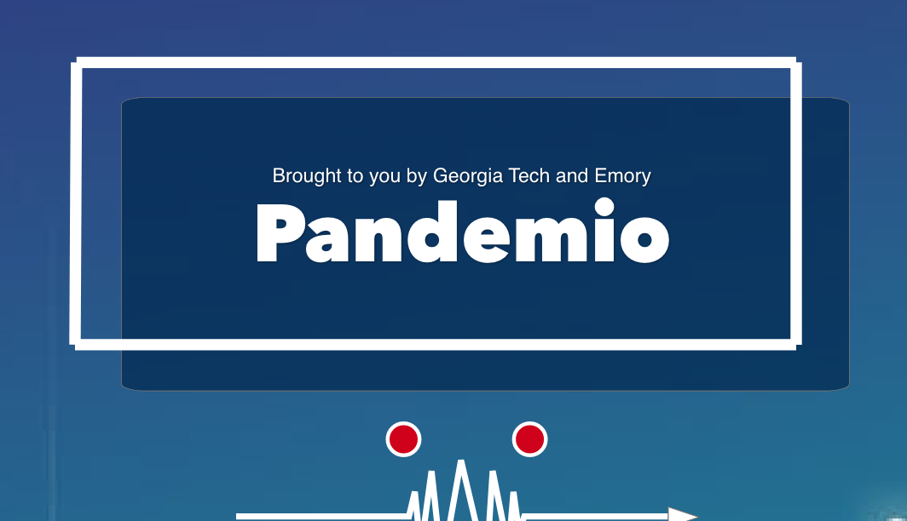

Our Solution
A website consisting of 2 complementary functions to provide information to individuals and businesses.
Data visualization - Educating on the effect of false negatives and test reliability through Data Visualization
Discussion Forum - Providing transparent and reputable information about testing on a centralized Forum.

Slide 4




Key Objectives
Informs Decisions
Educates on the effect of false negatives & testing in general
Convenient & Accessible
User-friendly website with easily understandable information
For Individuals & Businesses
To be informed on testing
Facilitates Testing
Educates and provides resources to aid in testing

Slide 5

Potential Impact
01. To be leveraged by colleges and companies to understand the impact of testing
02. Educate those who will be tested, a population estimated to exceed 450,000 individuals per day in the US
03. Application to visualize & educate on the spread other infectious diseases
Notes:
04. Potential to become a one-stop-shop for testing kits distribution

Slide 6
Timeline for Implementation
May
June
Aug
Sept
2020
2020
2020
2020
Refine data visualization, algorithms, and website
Beta launch available only to healthcare workers & companies by contacting them directly
Modification to make more user-friendly and launch to market. Invest in advertising to the public
Reach 10,000 users through partnerships with accredited organizations including testing labs, government, healthcare professional associations

Slide 7

Thank You

